Slide 1


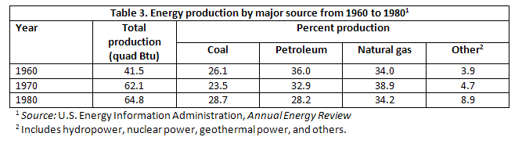
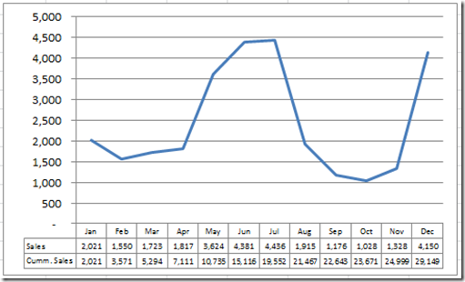
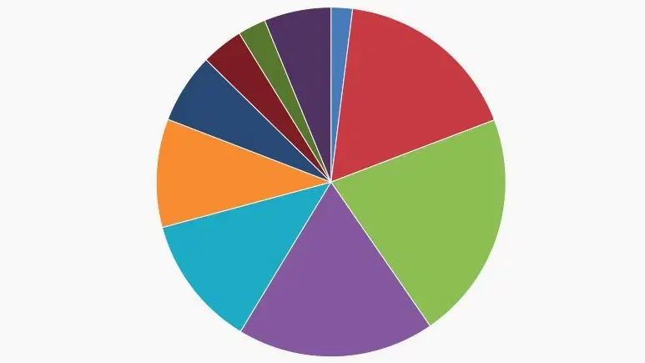
MALAVIYA NATIONAL INSTITUTE OF TECHNOLOGY JAIPUR (Calisto MT 50 pts BOLD)
Department of Humanities and Social Sciences (Calisto MT 48 pts BOLD)
2nd Pan NIT HSS International Conference on 'Resilience and Transformation for Global Restructuring’
ICRTGR 2022: 7-9 January 2022 (Calisto MT 48 pts BOLD)
Introduction (TNR 40 pts Bold)
Paper Title (TNR 48 pts BOLD)
References (TNR 40 pts Bold)
Sub Headings:
TNR, 28 pts, Left aligned, Paragraph spacing 6 pts
Content:
TNR, 24 pts, Justified aligned, Line spacing 1.5
The introduction should give a brief background of the topic you are discussing/presenting in your poster.
A brief of the relevance of the research must be presented here in the bulleted points or short paragraph. This should include a short background of the topic to set the context and state the main aims and objectives of your piece of work. What differentiates your work? Why is your work novel in the field?
.
Paper ID : 230ABC456 (TNR 40 PTS)
Content : TNR, 24 pts, Justified aligned, Line spacing 1.5, hanging indent
References should be mentioned in APA style formatting.
Miller-Rushing, A. J., Primack, R. B., Primack, D., & Mukunda, S. (2006). Photographs and herbarium specimens as tools to document phonological changes in response to global warming. American Journal of Botany, 93, 1667-1674.
Major Findings/Outcomes (TNR 40 pts Bold)
Highlight your large photographs, charts, maps, or in this central arena.
Annotate graphics with arrows and callout boxes so that viewer is visually led through how hypothesis is addressed. The goal is to enable viewers to understand the logic behind your conclusions without you needing to be there. The results section should include data analysis and stratification and should only include the results which answer the stated hypothesis. Moreover, essential to the results section is the inclusion of pertinent and key graphs, graphics, images and tables. These need to be large enough for the audience members to see and be as attractive and clutter-free as possible.
Table (number) : Description of the Table
Figure (number) : Description Figure (number) : Description
Objectives/Hypotheses (TNR 40 pts Bold)
Content : TNR, 24 pts, Justified aligned, Line spacing 1.5, hanging indent
The Objectives/Hypothesis should clearly state the objectives and/or hypothesis (for most presentations a statement of hypothesis is appropriate). A bulleted list works nicely for this section.
Methodology (TNR 40 pts Bold)
Discussions and Conclusion (TNR 40 pts Bold)
Recommendations (TNR 40 pts Bold)
Sub Headings : TNR, 28 pts, Left Aligned, Add Space after heading,
Content : TNR, 24 pts, Justified aligned, Line spacing 1.5
The methods section (poster space permitting) should include basic parameters including target sample, setting, duration of study, inclusion/exclusion criteria, statistical techniques, key interventions assessed and primary outcome measures.
Sub Headings : TNR, 28 pts, Left Aligned, Add Space after heading,
Content : TNR, 24 pts, Justified aligned, Line spacing 1.5
The conclusions must derive directly from the results section and answer solely what has been proposed at the start of the paper. Obvious confounders and limitations should also be acknowledged. Key improvements as well as potential for project expansion should also be considered.
Sub Headings : TNR, 28 pts, Left Aligned, Add Space after heading,
Content : TNR, 24 pts, Justified aligned, Line spacing 1.5
Mention the solutions to the problems you have investigated in your research paper poster. Your recommendations highlight specific solutions and measures to be implemented based on the findings of your research.
Author’s Name (TNR 40 pts Bold)
Designation
Affiliation
Email ID
Photograph

